Slide 1

The vector in TensorFlow
Notes:
1

Slide 2
Objectives
Process the IMDB dataset
Understand the vector in TensorFlow
Implementation the model
The vector in TensorFlow
2

Slide 3
The IMDB dataset
This is a dataset for binary sentiment classification containing substantially more data than previous benchmark datasets. We provide a set of 25,000 highly polar movie reviews for training, and 25,000 for testing.
Raw text and already processed bag of words formats are provided.
Link: https://ai.stanford.edu/~amaas/data/sentiment/aclImdb_v1.tar.gz
The vector in TensorFlow
3
Notes:
A "bag of words" (BoW) is a common technique used in natural language processing and text analysis. It is a simplified representation of a text document or a set of documents, focusing on the occurrence and frequency of words rather than their order or structure. The name "bag of words" suggests that you can imagine throwing all the words of a document into a bag and then analyzing the content based on the words present and their frequencies.
3

Slide 4
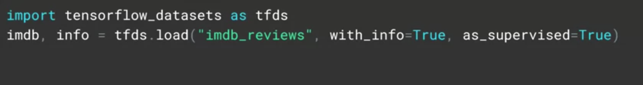
Process the IMDB dataset
import TensorFlow datasets
tfds.load, pass it the string imdb reviews, and it will return the data from imdb
The vector in TensorFlow
4
Notes:
4

Slide 5
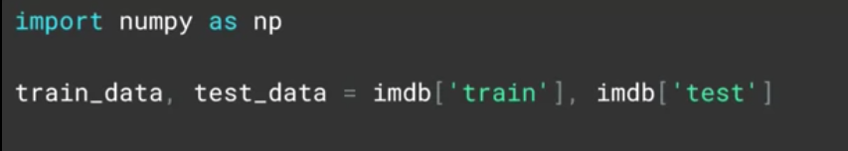
Process the IMDB dataset
The data is split into 25,000 samples for training and 25,000 samples for testing
The vector in TensorFlow
5
Notes:
5

Slide 6
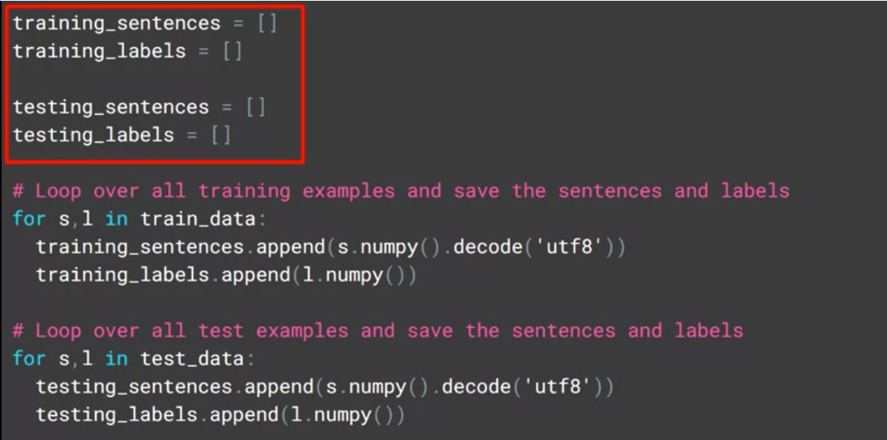
Process the IMDB dataset
Using the Keras tokenizers and padding tools on arrays of sentences.
Define lists containing the sentences and labels for both training and testing data
The vector in TensorFlow
6
Notes:
6

Slide 7
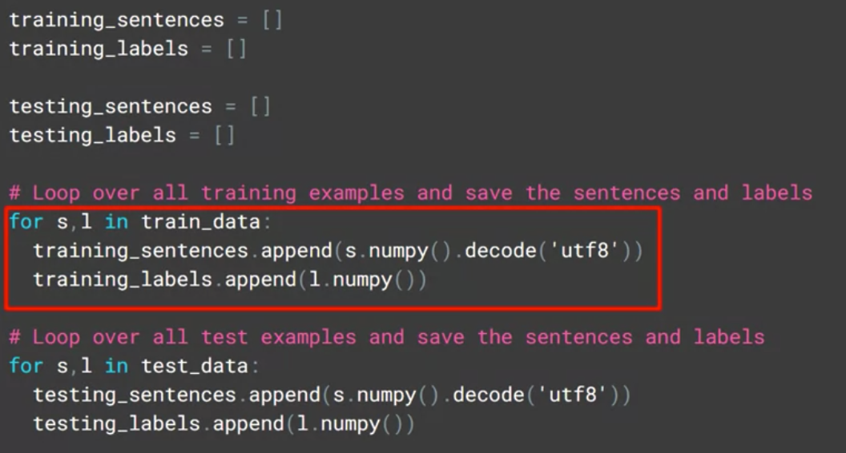
Process the IMDB dataset
Iterate over training data extracting the sentences and the labels
The vector in TensorFlow
7
Notes:
7

Slide 8
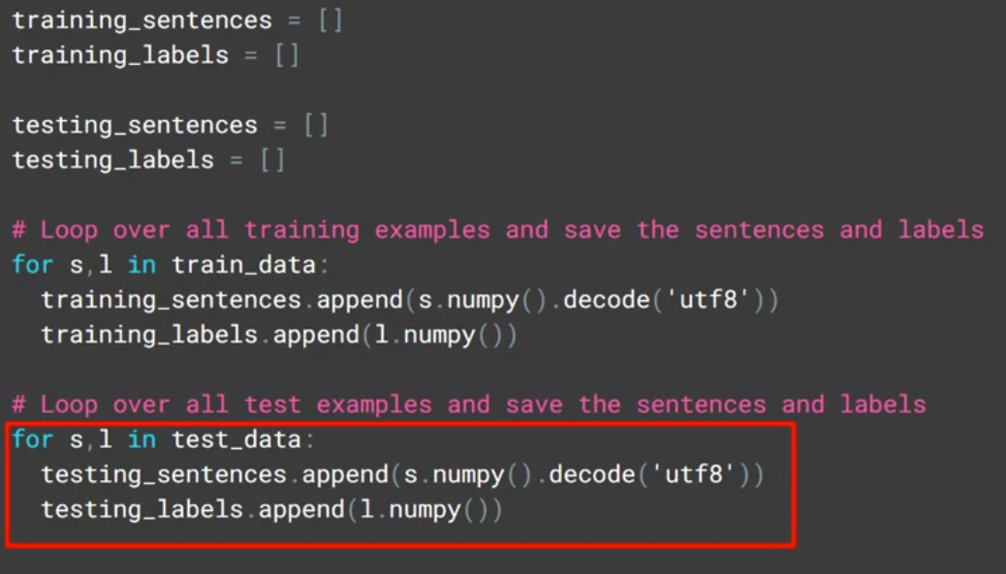
Process the IMDB dataset
Iterate over testing data extracting the sentences and the labels
The vector in TensorFlow
8
Notes:
8

Slide 9
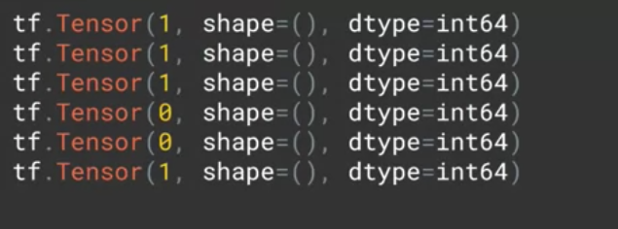
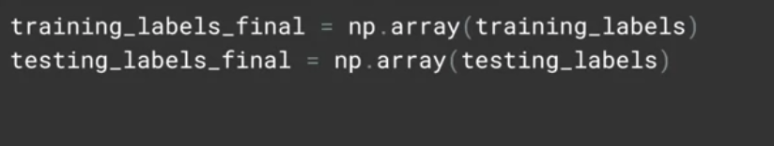
Process the IMDB dataset
Example of tensor is stored:
The value 1 indicates a positive review and zero a negative
When training, the labels are expected to be NumPy arrays.
The vector in TensorFlow
9
Notes:
9

Slide 10
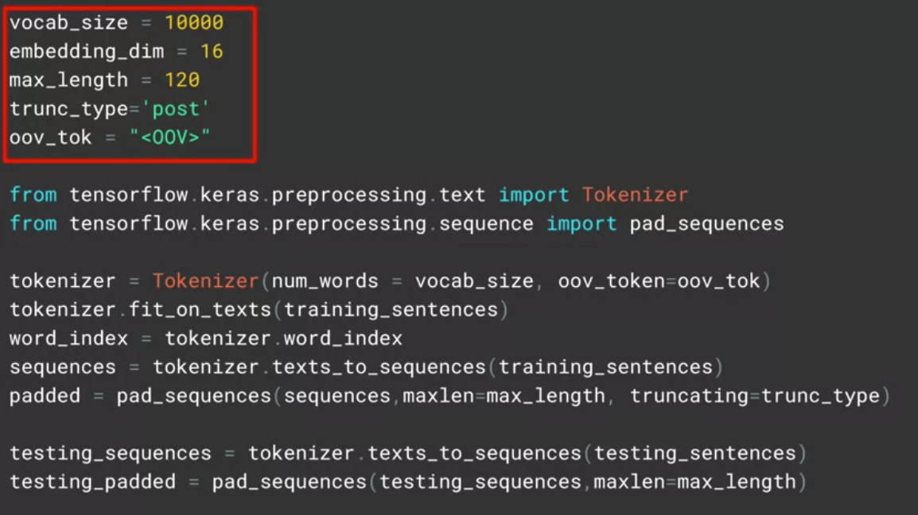
Process the IMDB dataset
Setup the hyperparameters
The vector in TensorFlow
10
Notes:
10

Slide 11
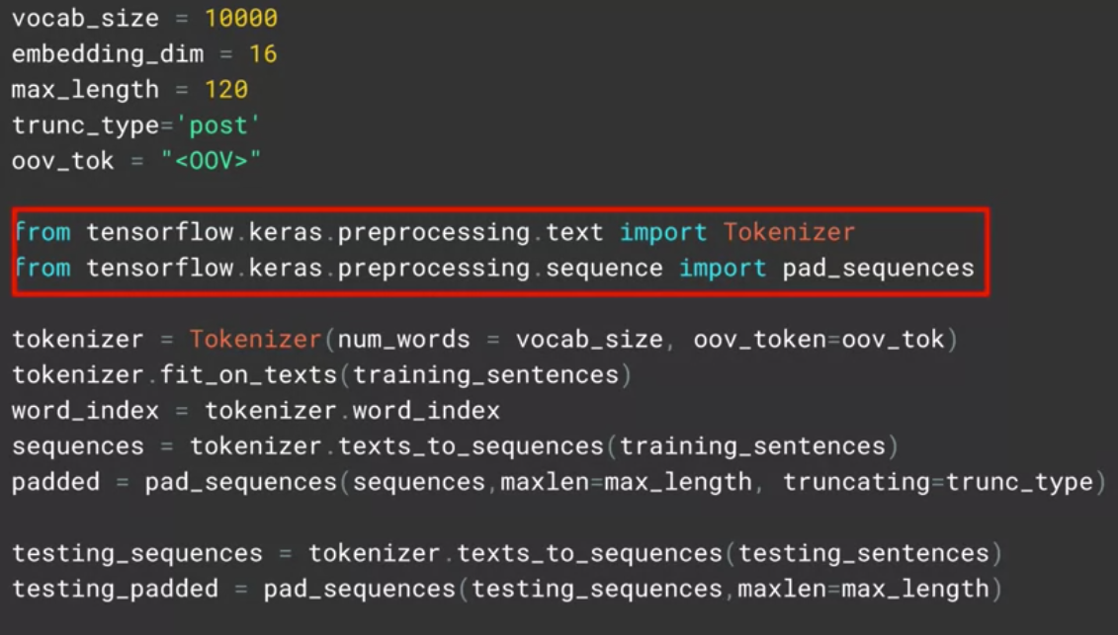
Process the IMDB dataset
Import the tokenizer and the pad sequences.
The vector in TensorFlow
11
Notes:
11

Slide 12
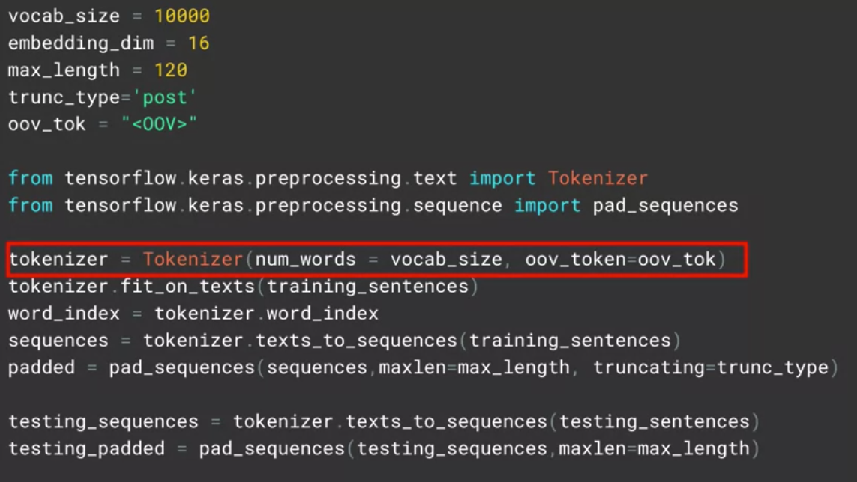
Process the IMDB dataset
Create an instance of tokenizer
The vector in TensorFlow
12
Notes:
12

Slide 13
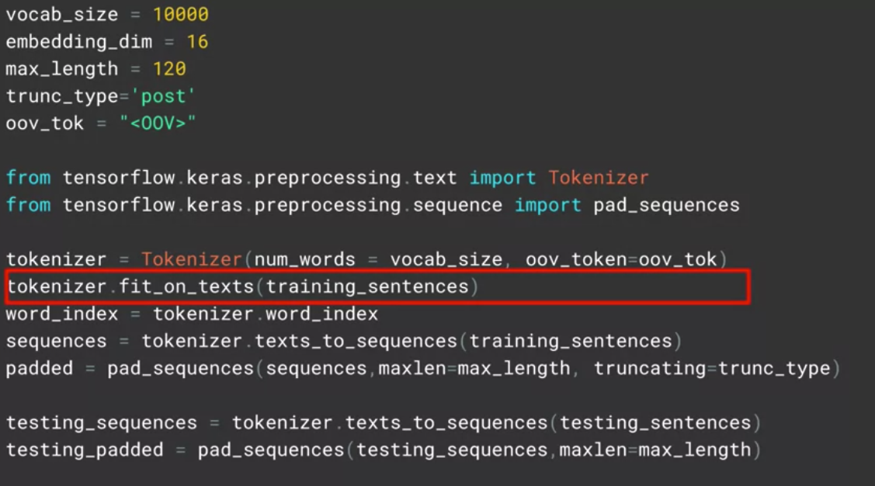
Process the IMDB dataset
Fit the tokenizer on our training set of data.
The vector in TensorFlow
13
Notes:
13

Slide 14
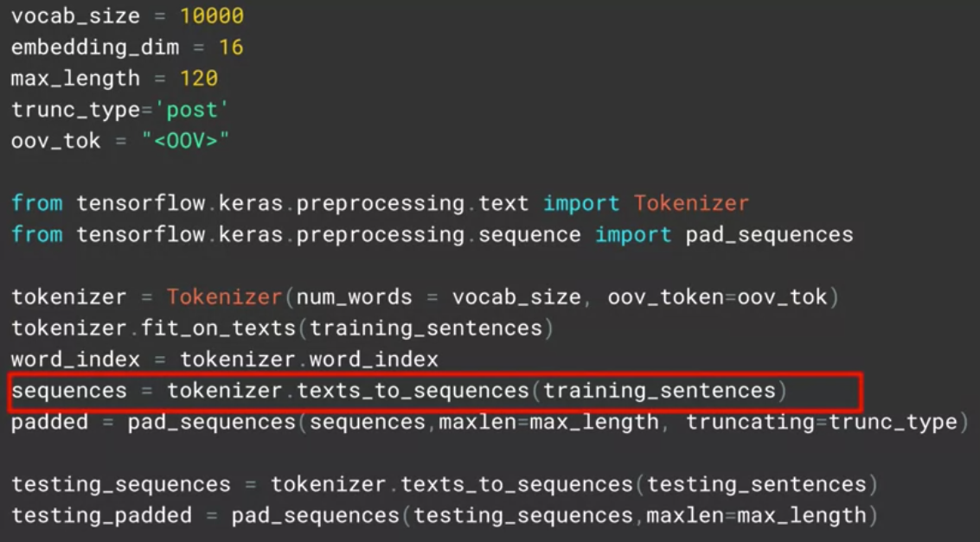
Process the IMDB dataset
Replace the strings containing the words with the token value we created for them
The vector in TensorFlow
14
Notes:
14

Slide 15
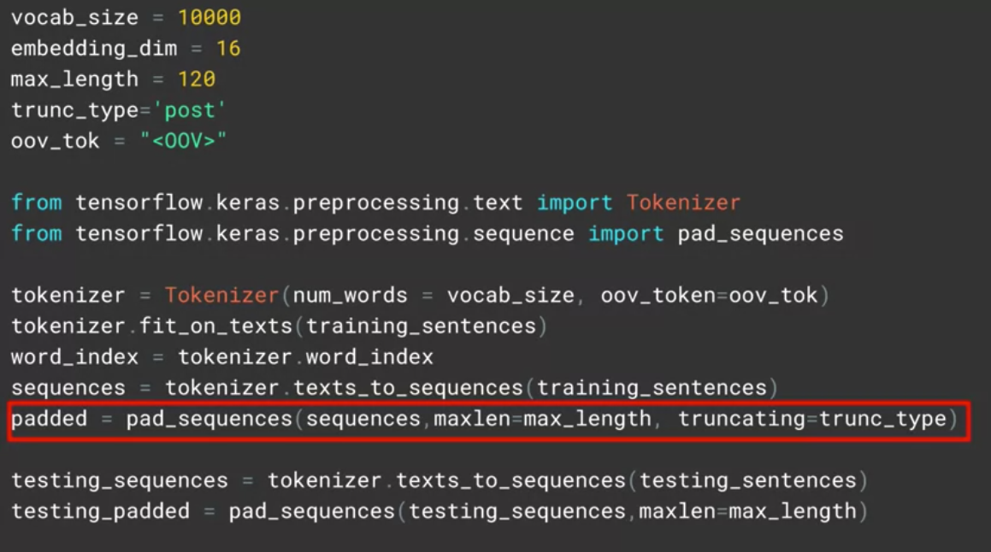
Process the IMDB dataset
Pad and or truncate the sequenced sentences until they're all the same length, determined by the maxlength parameter
The vector in TensorFlow
15
Notes:
15

Slide 16
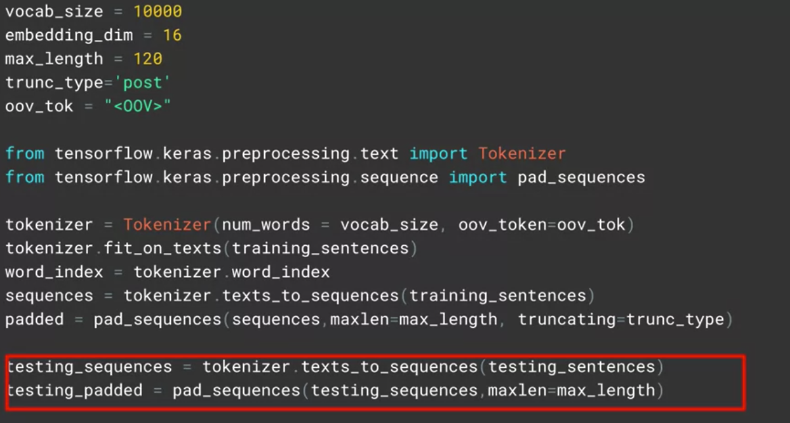
Process the IMDB dataset
Process for the testing sequences
The vector in TensorFlow
16
Notes:
16

Slide 17
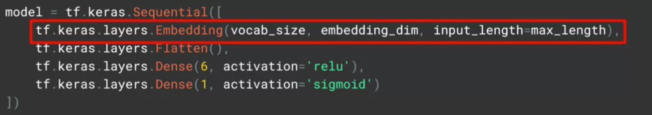
Process the IMDB dataset
Define our neural network.
The vector in TensorFlow
17
Notes:
17

Slide 18
The vector in TensorFlow
A tensor is a vector or matrix of n-dimensions that represents all types of data.
All values in a tensor hold identical data type with a known (or partially known) shape.
The shape of the data is the dimensionality of the matrix or array.
The vector in TensorFlow
18
Notes:
18

Slide 19
The vector in TensorFlow
The situation:
You have words in a sentence and often words that have similar meanings are close to each other. So in a movie review, it might say that the movie was dull and boring, or it might say that it was fun and exciting. So what if you could pick a vector in a higher-dimensional space say 16 dimensions, and words that are found together are given similar vectors. Then over time, words can begin to cluster together. The meaning of the words can come from the labeling of the dataset. So in this case, we say a negative review and the words dull and boring show up a lot in the negative review so that they have similar sentiments, and they are close to each other in the sentence.
Discuss and give your opinion
The vector in TensorFlow
19
Notes:
19

Slide 20
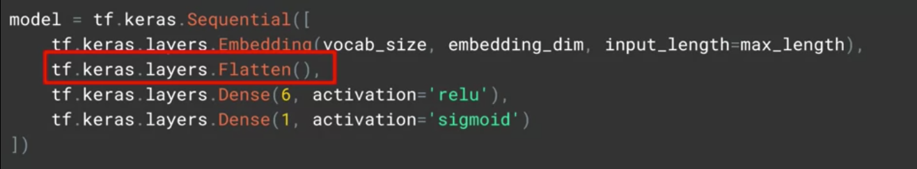
The vector in TensorFlow
The neural network trains, it can then learn these vectors associating them with the labels to come up with what's called an embedding, the vectors for each word with their associated sentiment.
The results of the embedding will be a 2D array with the length of the sentence and the embedding dimension
The vector in TensorFlow
20
Notes:
20

Slide 21
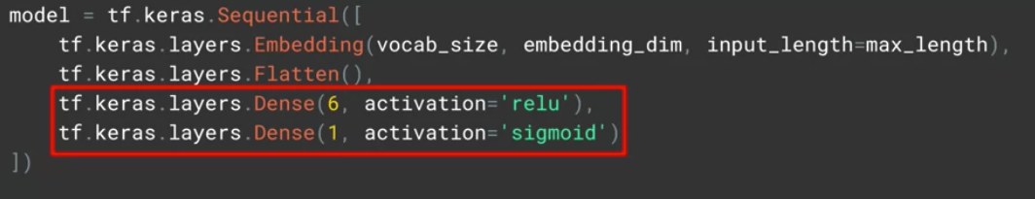
The vector in TensorFlow
Feed that into a dense neural network to do the classification
The vector in TensorFlow
21
Notes:
21

Slide 22
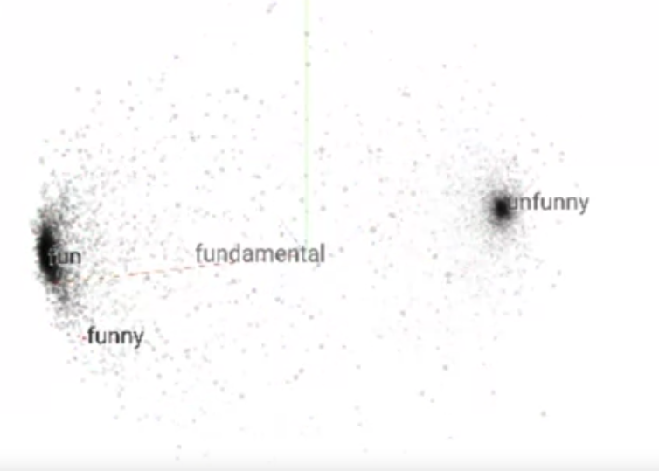
The vector in TensorFlow
2 centrals: Fun – Boring: fun, funny closed together
→ discuss and give opinions
The vector in TensorFlow
22
Notes:
This is the problem of dividing two clusters: fun and unfun. Each new word appears depending on its meaning, it will be assigned to different clusters. The closer the meaning of the new word will be located closer to the center.
22

Slide 23
Summary
Process the IMDB dataset
Understand the vector in TensorFlow
Implementation the model
The vector in TensorFlow
23

Slide 24
Q & A
The vector in TensorFlow
24

